Slide 1
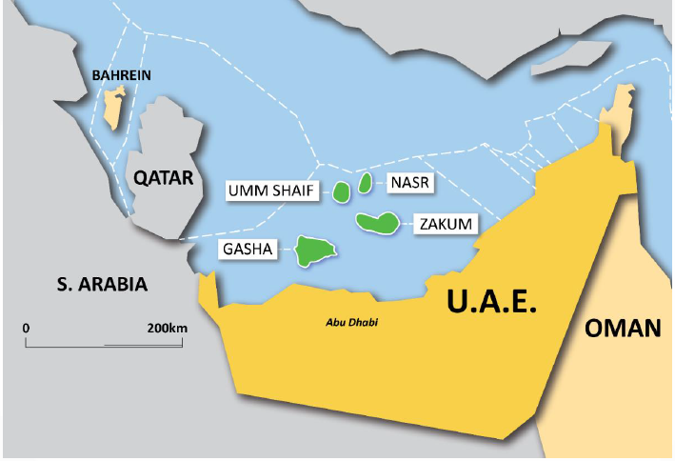
ENI ACTIVITIES IN ABU DHABI
SHARJAH
DUBAI
RUWAIS
ABU DHABI

Slide 2
ENI ACTIVITIES IN ABU DHABI
ENI ESTABLISHES A LONG TERM PRESENCE IN UAE ACQUIRING A STAKE IN TWO OFFSHORE PRODUCING CONCESSIONS
11 March 2018
875 million US dollar years concessions
5% stake in the Lower Zakum offshore oil field
10% stake in the oil, condensate and gas offshore fields of Umm Shaif (460 Bopd) and Nasr (450 Bopd)
Eni sold to Mubadala Petroleum a 10% stake in the Shorouk concession,
offshore Egypt, where Zohr's super-giant gas field is located.
934 million US dollar
13 November 2018
120,000 barrels of oil per day
ENI SIGNS GHASHA GAS CONCESSION WITH ADNOC STRENGTHENING ITS PRESENCE IN THE UNITED ARAB EMIRATES
By 2025:
~ 1.5 billion cubic feet of gas per day
25% stake in ADNOC’s mega offshore gas project
12 January 2019
ENI EXPANDS ITS PRESENCE IN UAE ACQUIRING A MAJORITY STAKE IN TWO OF ABU DHABI’S OFFSHORE EXPLORATION CONCESSIONS
70% stake in the Block 1 and Block 2 offshore exploration areas for a duration of 35 years

Slide 3
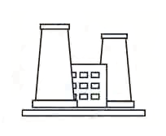
ABU DHABI AND RUWAIS REFINERIES
27 January 2019
ENI ACQUIRES A 20% EQUITY INTEREST IN ADNOC REFINING
THE TWO COMPANIES CONSOLIDATE
THEIR STRONG PARTNERSHIP
35% growth in Eni’s refining capacity
ADNOC total refining production capacity (over 900,000 barrels per day)
This acquisition allows Eni to reduce its overall refining breakeven target margin by 50% down to around 1.5$/bbl
The deal makes Eni’s portfolio more integrated along the energy value chain and more resilient to market volatility
SHARJAH
DUBAI
RUWAIS
ABU DHABI

Slide 4
ENI IN SHARJAH: ACTIVITIES AND STRATEGY
13 January 2019
ENI ENTERS IN THE SHARJAH EMIRATE SIGNING AREAS A, B AND C EXPLORATION CONCESSIONS ONSHORE
- Area A and C: Eni will act as Operator with 75% participating interest
- Area B: participating interest with Eni holding 50% of stake
“These agreements mark for Eni another major step towards an organic growth in the UAE”.
Eni’s CEO, Claudio Descalzi
SHARJAH
DUBAI
RUWAIS
ABU DHABI

Slide 5
ENI GLOBAL STRATEGY IN THE UNITED ARAB EMIRATES
11 March 2018
Eni enters one of the largest hydrocarbons reserves Country in the world
13 November 2018
Eni settles its strategy of growing in the Middle East which is based on the integration of exploration and development
Eni reconfirms its ability in developing discoveries in a record time-to-market
First-ever open block licensing
Eni will make available its exploration expertise and leading edge technology to untap additional resources in the Offshore of Abu Dhabi
These awards marked the first time an Italian energy company was granted concession rights in Abu Dhabi’s oil and gas sector
12 January 2019
Eni strengthens its partnership with ADNOC
Eni makes another major step towards an organic growth in the UAE and marks the willingness to root its presence by creating long-term further strategic partnerships
13 January 2019

Slide 6
ENI IN OMAN: ACTIVITIES AND STRATEGY
14 January 2019
ENI SIGNS EXPLORATION AND PRODUCTION SHARING AGREEMENT FOR BLOCK 47, ONSHORE OMAN
Eni is the Operator of block and with a 90% participating interest
Further possibility of expansion in Country through the HoA for block 77
Eni and BP strengthen their cooperation (following the recent agreements in Libya with the aim to launch the acquisition process to obtain a 42.5% participating interest and the assignment of the operatorship in two onshore and one offshore contractual areas and the entry of BP as new partners in Nour, Egypt)
SHARJAH
DUBAI
SHARJAH
DUBAI
RUWAIS
ABU DHABI
RUWAIS
ABU DHABI

Slide 7
ENI IN BAHREIN: ACTIVITIES AND STRATEGY
13 January 2019
ENI SIGNS A MOU TO THE ALLOCATION OF EXPLORATION RIGHTS FOR BLOCK 1 OFFSHORE
A new potential acquisition in Eni’s Middle East portfolio (UAE, Oman, Lebanon, Bahrain and Iraq)
“We are delighted with the signing of this agreement and will allow Eni to start cooperating and investing in a country that was one of the first in the Gulf to produce oil and which now aims at unveiling its offshore potential”.
Eni’s CEO Claudio Descalzi
SHARJAH
DUBAI
RUWAIS
ABU DHABI

Slide 8
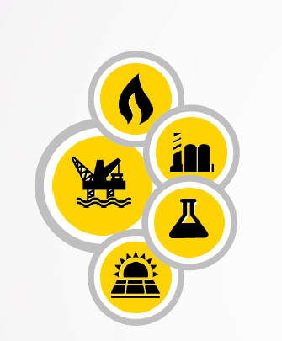
ENI STRATEGIC DRIVERS IN THE MIDDLE EAST
GROWTH LEVERS
Upstream and refining growth in M.E.
Stronger presence in a very promising region, leader in the global oil market while expanding in the refining sector
Synergies, low exploration and production costs
Low project complexity, expected time-to-market development
VALUE GROWTH
Eni.com dossier
Ita https://www.eni.com/it_IT/media/dossier/eni-in-medio-oriente.page
Eng https://www.eni.com/en_IT/media/focus-on/eni-in-the-middle-east.page

